Slide 1

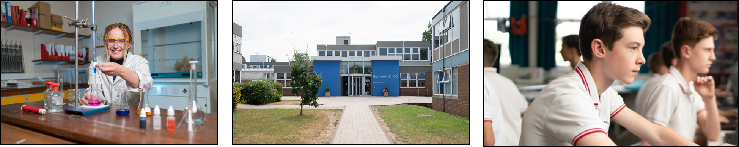
Year 9 Options
2025
Notes:
Welcome to the second video on the Y9 option process.
The aim of this video is to guide you through the KS4 curriculum emphasising what subjects your child will have to continue studying as well as what subjects they will have a choice in taking.

Slide 2

Our aims are
For students to study a curriculum that suits their abilities, skills and aspirations
For students to follow a curriculum that is broad and balanced
For students to be given the opportunity to focus on their strengths and to explore new areas of interest
For students to be able to access a range of future choices at the end of Year 11

Slide 3
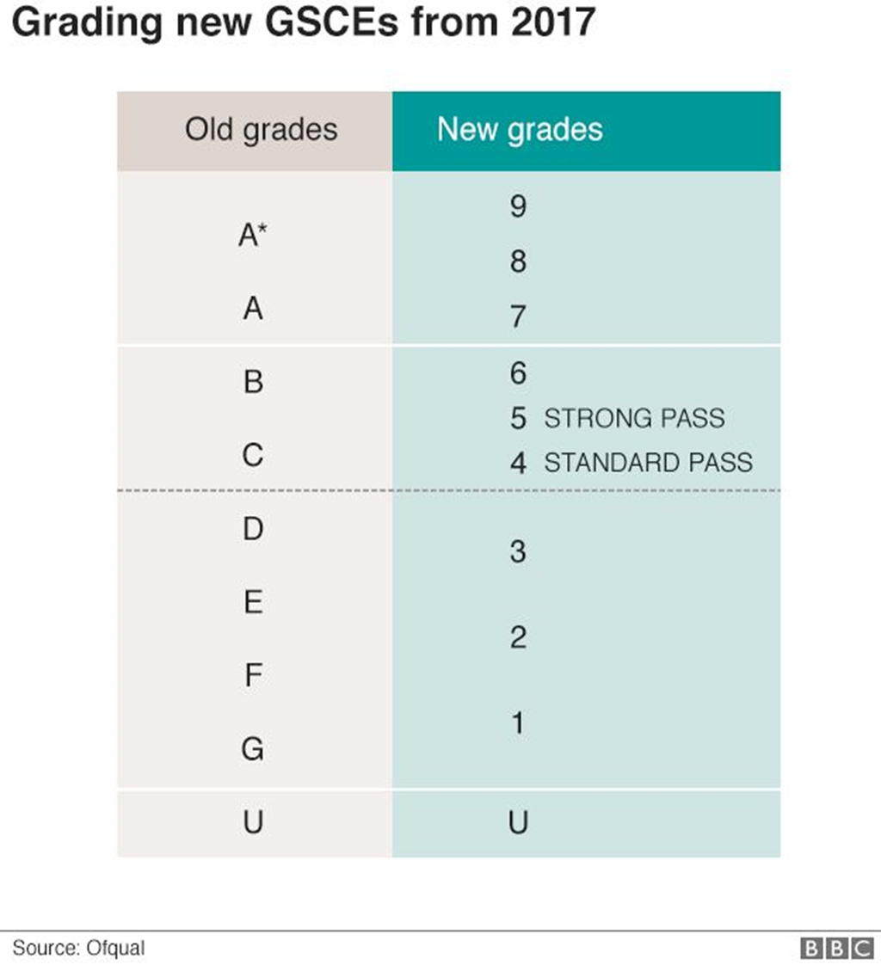
All GCSE courses are graded from 1-9
Grade 4 is a standard pass
Grade 5 is a strong pass
Notes:
Four years ago, KS4) went through significant reform. The content, assessment methods and the way that individual subjects are graded all changed with the aim of making level 2 qualifications (GCSEs and equivalents) more robust. As a school we have been delivering these new style qualifications for over 4 years now – we are confident in how we do this and many of the changes we have made in the KS3 your son or daughter have been following will have adequately prepared them to take on the challenge of Years 10&11.

Slide 4

The core curriculum
Maths
English Language
English Literature
Science (either double or triple)
Modern Foreign Language*
History
Geography
and/or
Notes:
For the first time in your child's education, they have some choice in what subjects they want to study, however there are certain subjects that they have to continue to Year 11 – we call this our core curriculum. Maths, English language, English Literature and Science.
It’s worth highlighting that English Lang and English Lit are two separate subjects where a grade for each one will be awarded
We make the decision on whether your child will take double or triple science on the basis of what would be suitable for them. Which ever course they take will allow them entry to science based qualifications in our sixth form as well as other Post-16 providers providing they meet any entry requirements.
In addition we also expect that students continue with their modern foreign language to GCSE. If your son/daughter is currently taking two languages they choose which one they would like to take for GCSE or they can take both. If they choose to take both then the second language would count as one of their option subjects which I’ll explain about in the next slide. We recognise that it might not be in every students best interest to continue with a language and if this is the case we will contact you and your child will choose an additional option subject in lieu of this.
In addition to these subjects we also ask students to choose either geog or hist. Students can, if they want, choose both of these subjects with the other as one of their option subjects.
Our core curriculum is designed to develop students knowledge and skills which will help them in the next stages of their education or training.

Slide 5
Options curriculum
Students choose two options subjects
Students need to make a 1st and 2nd choice
Students will also have to choose two reserve subjects again in order of preference
All subjects lead to a GCSE qualification apart from those in red which are L2 vocational courses
Computer science: appropriate for students in maths sets 1-3
History
Geography
P&R
PE/Sports studies
Performing Arts
Drama
Music
French
German
Spanish
Design technology
Food preparation and nutrition
Sociology
Business studies
Computer science
Art, craft and design
Art textiles
Photography
Notes:
As mentioned earlier your child does get an element of choice over which subjects they want to study in Ys10 and 11 – we call this our options curriculum where most students will have to choose two of the following subjects
Many of these subjects will be familiar to you and your child because they currently study them. However, you’ll also notice that there are some subjects we offer which they won’t have studied before because we don’t teach them at KS3. We will look later at how students can find out about this courses and their suitability for them.
We would like to be able to guarantee students all of their choices but this might not always be possible due to group sizes or time tabling restrictions. This is why we ask students to make their choices in order of preference. This is really important because if we cannot give a student their first choice we use order of preference to allocate places. For the same reason we also ask you child to choose two reserve subjects which we also ask are made in order of preference. Should your child not be able to be given their first preferences of subject, we will automatically allocate them their first reserve. So clearly reserve choices are important too – your child has to be prepared to take them if they have to For reassurance the vast majority of students do get their first choices (98% last year).
All the subjects on this list lead to GCSE qualifications with the exception of those in red. These lead to different qualifications but are equivalent to GCSE level – we call them vocational subject which I will explain in a bit more detail in the next slide
Computer science is the only subject with a entry restriction. Because of the significant level of maths input needed for this course we ask students be in maths set 1-3.

Slide 6
What are vocational qualifications?
They are a level 2 qualification i.e. the equivalent of a GCSE
They are assessed through a mix of exams and assessments (coursework)
The curriculum in these subjects is more practical than most GCSEs
They are NOT an easy option
They are graded differently (pass, merit, distinction)
Performing Arts
Sports Studies

Slide 7

KS4 curriculum
Maths
English Language
English Literature
Science (either double or triple)
Modern Foreign Language
History and/or geography
Option 1
Option 2
Personal Development
Core PE

Slide 8
Good reasons for students to choose subjects
They enjoy the subject and will work hard
They have found out about what they will learn in that subject in years 10-11
They have spoken to subject teachers/older students/their tutor about the subject
They have listened to the advice they have been given

Slide 9
Bad reasons to choose subjects
They like the teacher they have in Y9 for that subject
Their friends have chosen that subject
They think they will like it because it’s something different but haven’t done any research or spoken to anyone about it
They ignore the advice they have been given

Slide 10
What happens next?
Read the options booklet
Visit the subject showcase to find out more about options subjects, talk to subject staff and current GCSE students
Do your research -Talk to subject teachers/older students/ tutors to find out more about subject choices
Fill in the options form and hand it in to Student Services by Wednesday 26 February

Slide 11
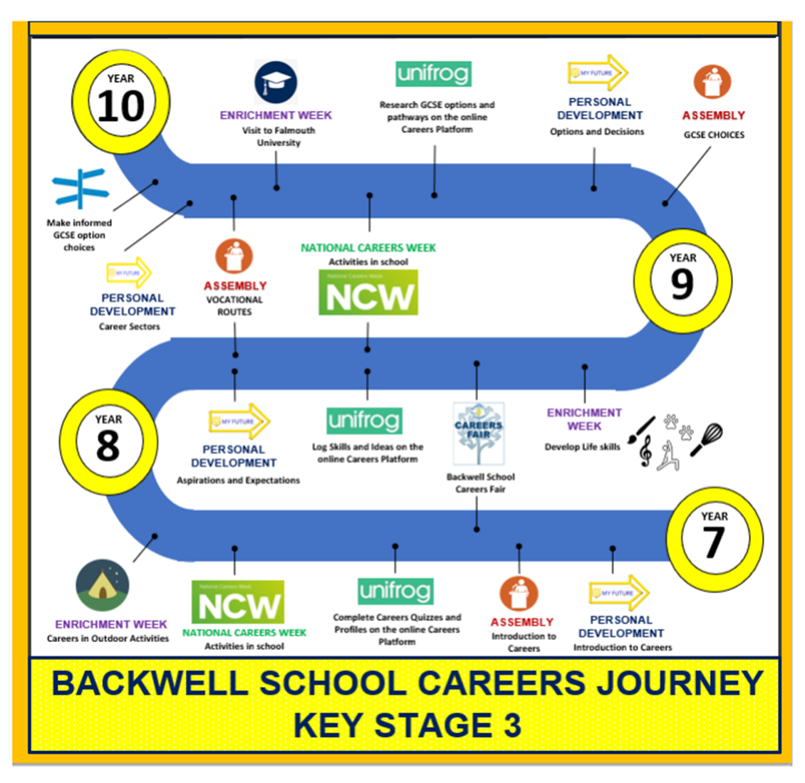

Slide 12

Exploring pathways
Recording what you’ve done
Searching for opportunities
Drafting application materials
Making applications
Careers library
Activities
UK universities
UK Personal Statement
Post 16/18 Intentions
Subjects library
Competencies
US universities
Academics
Locker
Know-how library
Interactions
European universities
CV / Resumé
Applications list
MOOC
Oxbridge
Common App Essay
Personality profile
Apprenticeships
US recommenders
Interests profile
College / Sixth Form
Notes for Ref Writers
Canadian universities
Asian universities
Australasian unis
Create an account
Special opportunities
Sign up
ME and African unis
Irish universities
Parents/carers can register using the formcode: BACKparentscarers

Slide 13
SUBJECT SHOWCASE- Sixth form block
6th form canteen | geography, history, P and R, languages, careers
6th form theatre | art, food, photography, textiles, design technology
Dance studio | drama, music, performing arts
SF4 | computing
SF1 | business, sociology
SF2 | PE, sports studies

